Slide 1

Contract Monthly Claim System (CMCS)
Streamlining Claims Management for Universities
Efficiency and automation for claim processing.

Slide 2
Introduction to CMCS
The Contract Monthly Claim System (CMCS) is designed to streamline the processing of claims submitted by lecturers at a university.
It ensures efficiency, reduces manual errors, and simplifies communication between lecturers, coordinators, managers, and HR.
Challenge it Solves: Managing large volumes of claims accurately and timely.

Slide 3
Core Features of CMCS
- Lecturer View: Submit claims, upload documents, and track statuses.
01
- Coordinator/Manager View: Approve/reject claims and add rejection reasons.
02
- HR View: Generate reports, manage lecturer data, and automate payroll processing.
03

Slide 4
Technologies Used
- Frontend: ASP.NET MVC
- Backend: .NET Core, Entity Framework Core
- Database: SQL Server
- Authentication: ASP.NET Identity with role-based access control
- File Uploads: Supporting document uploads stored securely.

Slide 5
Role-Based Features
Submit
- Lecturers: Submit claims, upload documents, and view statuses.
Approve/reject
- Coordinators/Managers: Approve/reject claims and provide feedback.
View
- HR: View consolidated approved claims, generate reports, and update lecturer data.

Slide 6
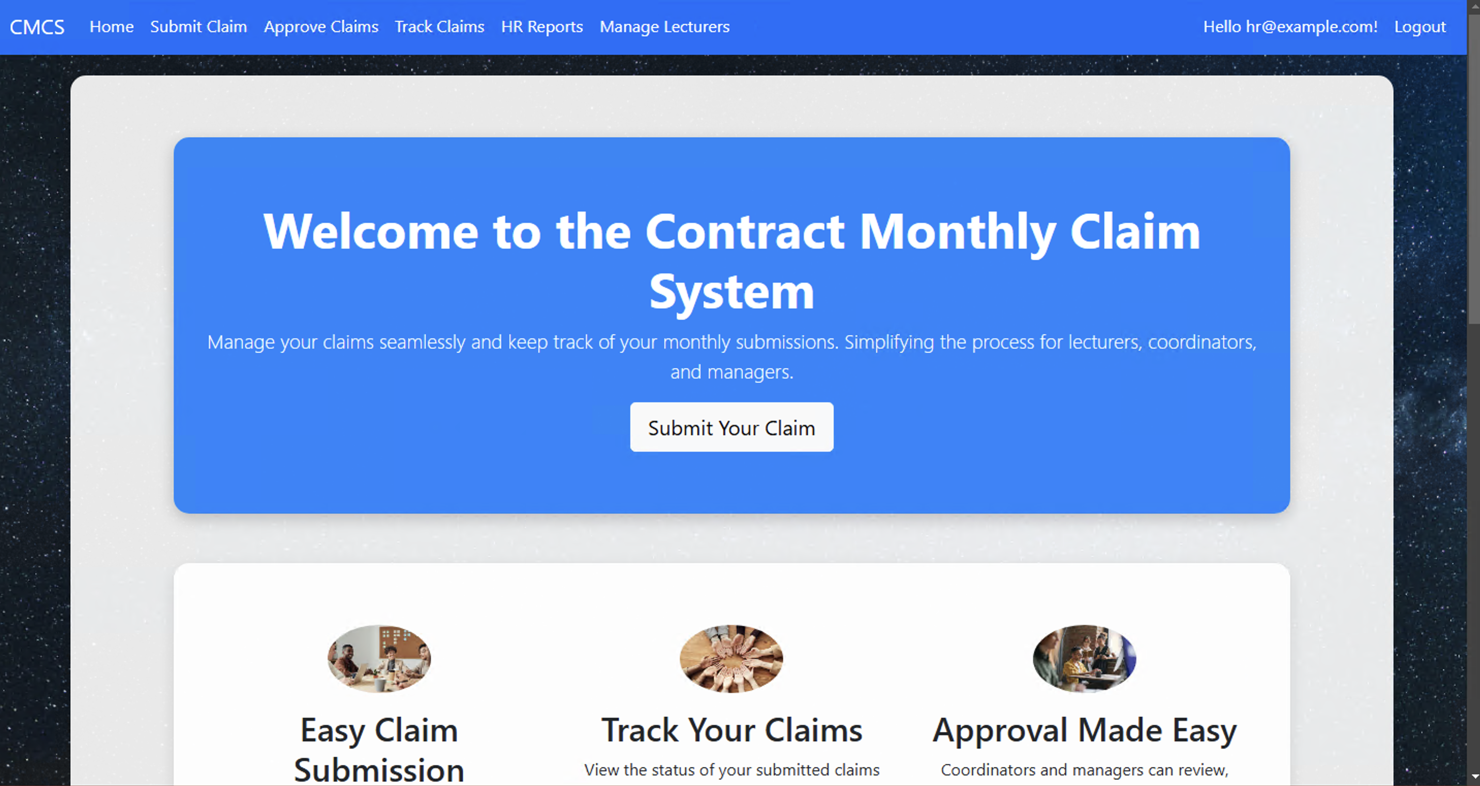
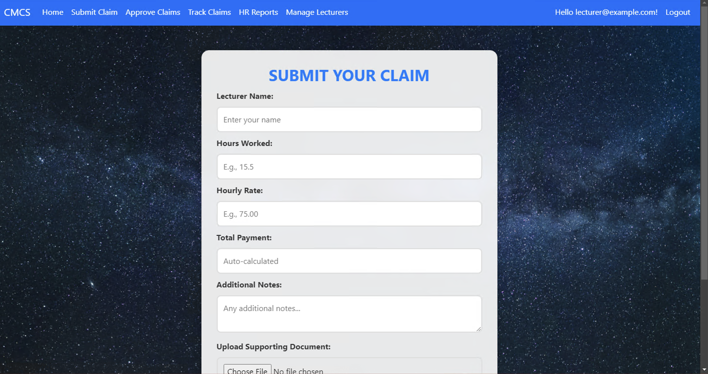
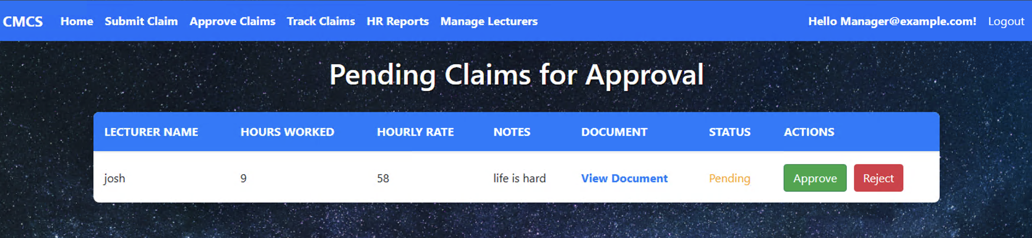
How the CMCS Looks:

Slide 7
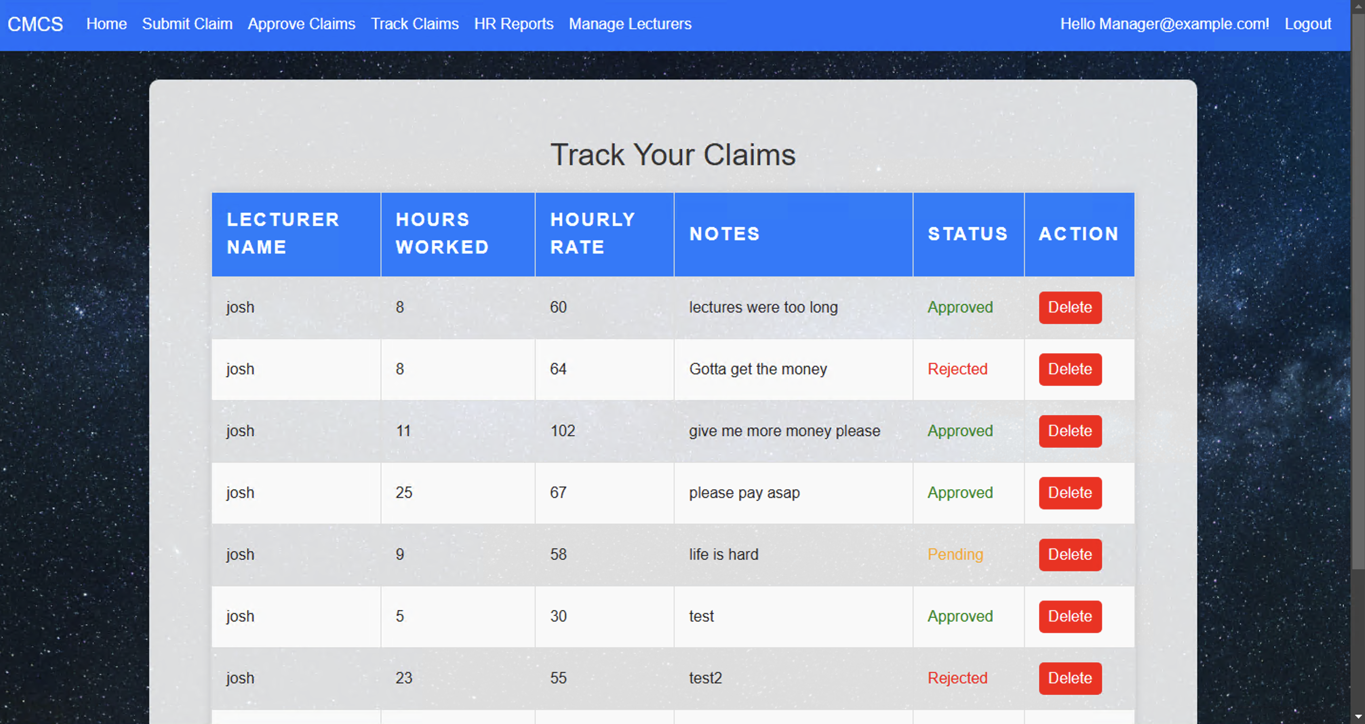
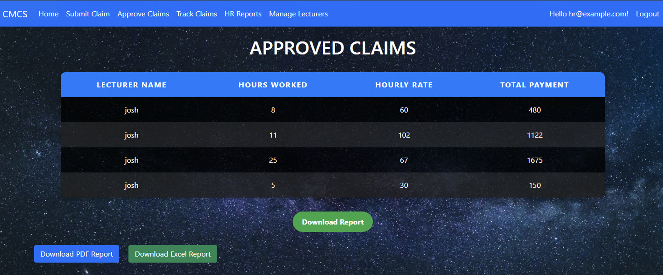
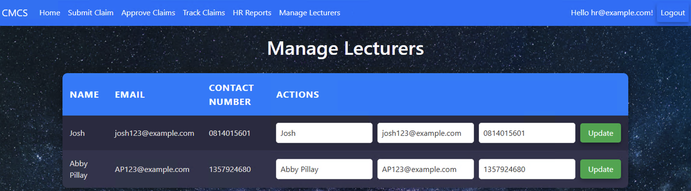
How the CMCS Looks:

Slide 8
How CMCS Works
1. Lecturer submits a claim with supporting documents.
2. Claim is reviewed by a coordinator/manager.
3. HR processes approved claims and generates payroll reports.
4. The system ensures transparency at every stage.

Slide 9

Benefits of CMCS
- Automates claim submissions and approvals, reducing manual effort.
- Ensures transparency and accountability with role-based access.
- Improves communication across departments.
- Generates automated financial reports for payroll processing.

Slide 10
Development Challenges
- Integration with SQL Server for efficient data storage.
- Configuring ASP.NET Identity for role-based authorization.
- Handling secure uploads of supporting documents.
- Ensuring dark-mode compatibility for user-friendly design.

Slide 11
Next Steps
- Add email notifications for claim updates.
1
- Implement detailed analytics for HR.
2
- Enhance mobile responsiveness for accessibility.
3
- Integrate with external payroll systems for seamless processing.
4

Slide 12
Conclusion
CMCS enhances efficiency, transparency, and accuracy in managing contract claims.
The system addresses challenges faced by universities and provides a scalable solution for claim management.

Slide 13
Thank You
Questions or feedback?
Presented by: [Joshua Ryan Pillay]
St Number: [10175525]
Project: Contract Monthly Claim System (CMCS)

